Slide 1
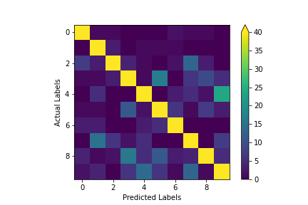
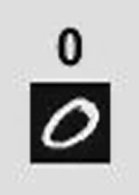
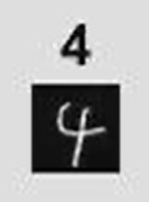
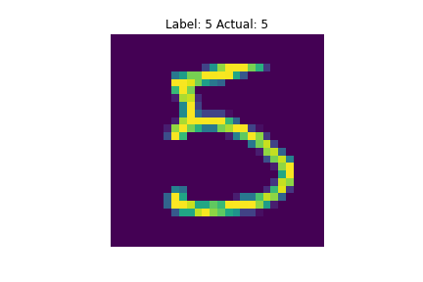
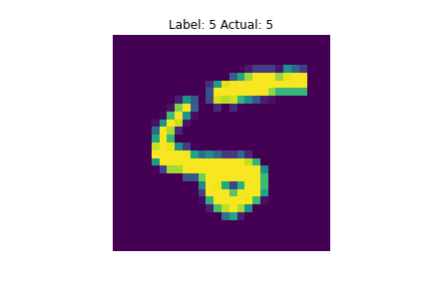
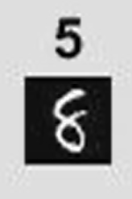
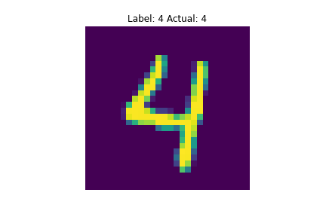
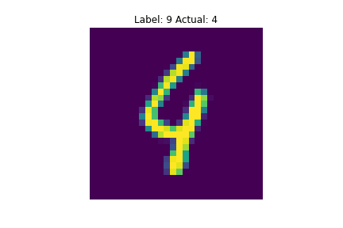
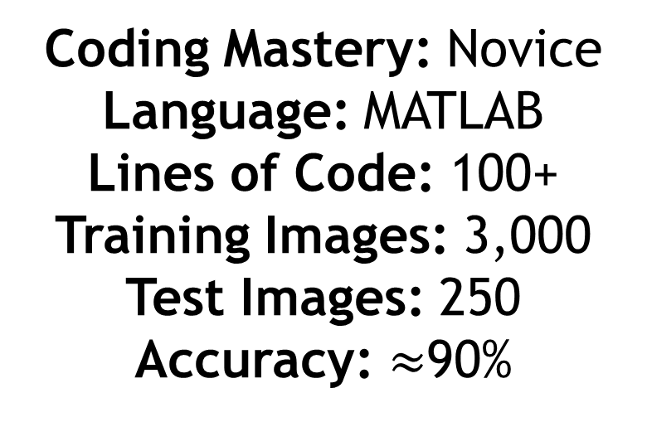
2019
2021
Coding Mastery: Novice
Language: MATLAB
Lines of Code: 100+
Training Images: 3,000
Test Images: 250
Accuracy: $≈$90%
Coding Mastery: Experienced
Language: Python
Lines of Code: 19
Training Images: 60,000
Test Images: 10,000
Accuracy: 96.94%

